Slide 1
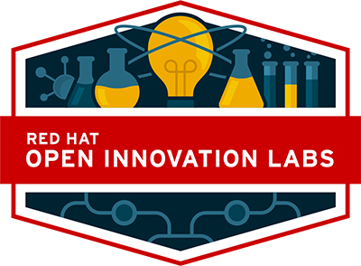

DevOps Culture and Practice Enablement
Containers, Registries, OpenShift (Kubernetes) Overview

Slide 2


Topics
Containers
What are containers?
Registries (Image Registries)
What are container images and image registries?
OpenShift / Kubernetes
What exactly is OpenShift and Kubernetes?
Notes:
Briefly introduce the topics contained within this page

Slide 3
Containers
NORTH AMERICA - November 2019 All-Hands Call
Notes:
Accessing Student VMs through Workstation Port Forwarding
Accessing Student VMs through Bastion Port Forwarding

Slide 4
Container
A container is basically a running, virtualized application in a self-contained package. Containers are based on a container image which consists of the entire runtime environment including:
The application
All libraries and dependencies
Additional binaries needed by the application
Configuration files needed to run the application
https://www.redhat.com/en/topics/containers

Slide 5
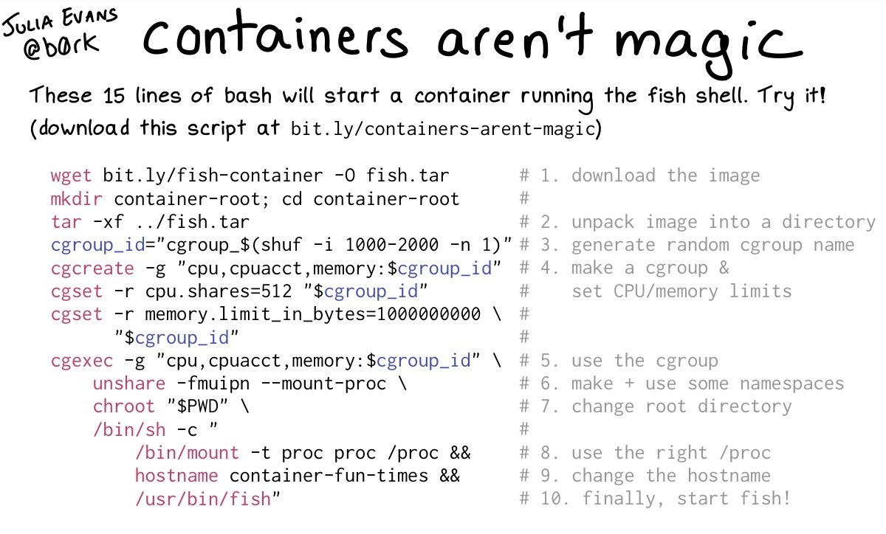
Containers

Slide 6
Registries
NORTH AMERICA - November 2019 All-Hands Call
Notes:
Instructor ToolKit
MOJO - New Site
RHLC
Knowledge management
RHU ROL / public ROL

Slide 7
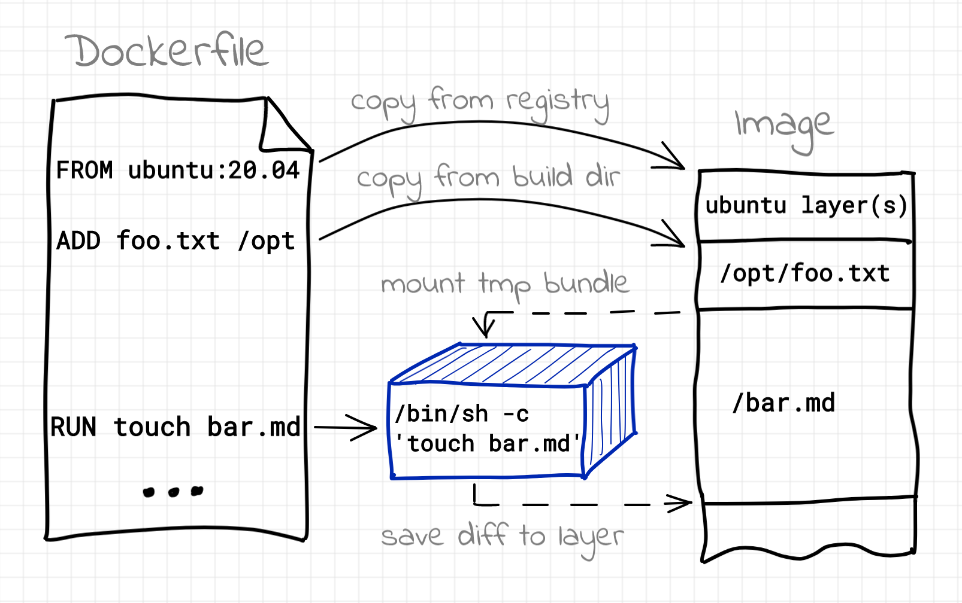
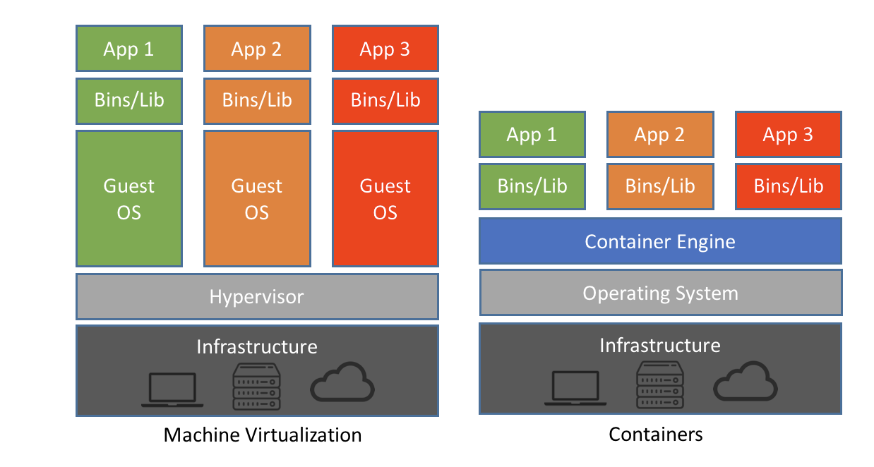
Container Image
A container image, in its simplest definition, is a file which is pulled down from a Registry Server and used locally as a mount point when starting Containers. Container images can be built based on instructions called Dockerfiles.
https://developers.redhat.com/blog/2018/02/22/container-terminology-practical-introduction

Slide 8
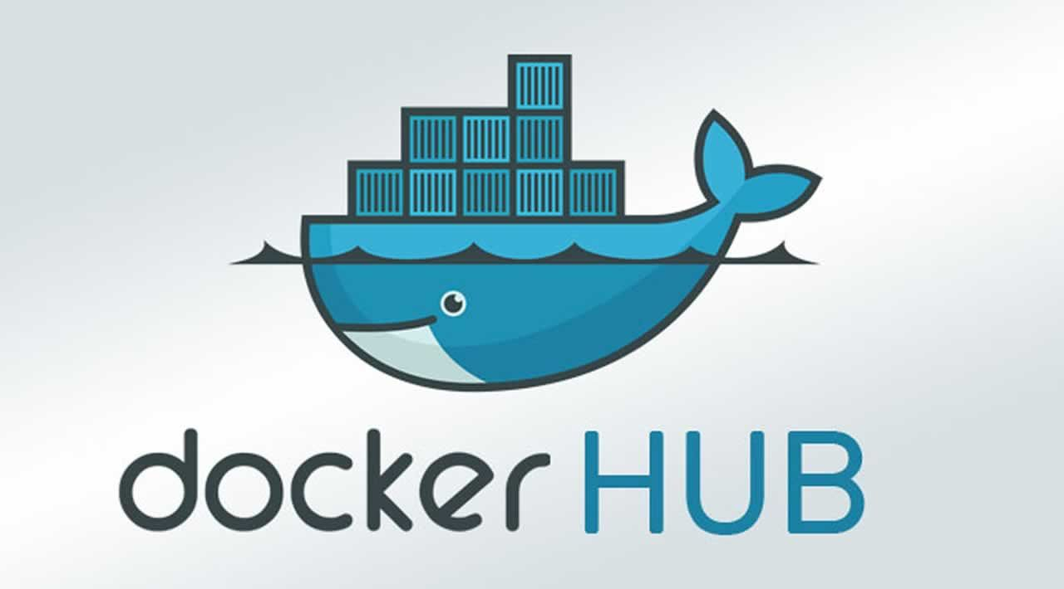
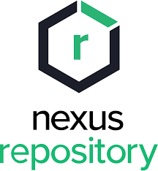
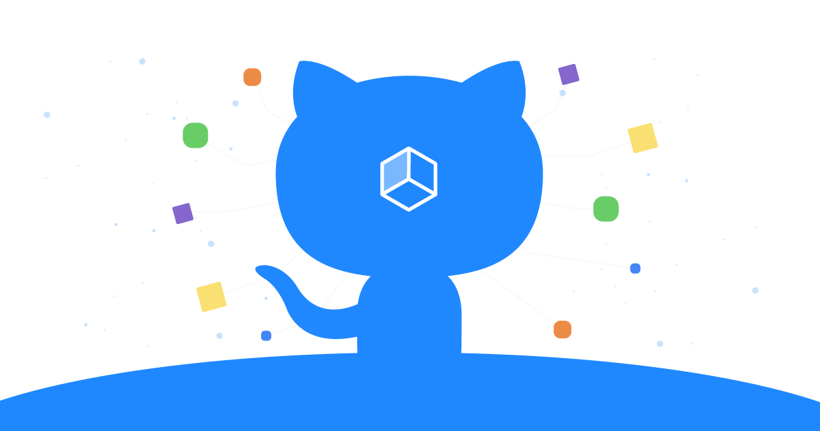

Container Image Registries
A container registry is a repository, or collection of repositories, used to store container images for Kubernetes, DevOps, and container-based application development.
https://www.redhat.com/en/topics/cloud-native-apps/what-is-a-container-registry#:~:text=A%20container%20registry%20is%20a,and%20container%2Dbased%20application%20development

Slide 9
OpenShift
&
Kubernetes
NORTH AMERICA - November 2019 All-Hands Call

Slide 10
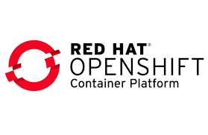
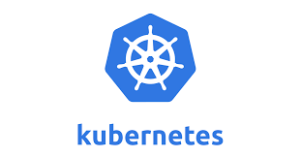
OpenShift and Kubernetes
Kubernetes is an open-source container-orchestration system for automating computer application deployment, scaling, and management. It was originally designed by Google and is now maintained by the Cloud Native Computing Foundation (CNCF). Kubernetes is a portable, extensible, open-source platform for managing containerized workloads and services, that facilitates both declarative configuration and automation
Red Hat® OpenShift® is an enterprise-ready Kubernetes container platform with full-stack automated operations to manage hybrid cloud, multi-cloud, and edge deployments. Extends existing Kubernetes framework with:
Routes
Dashboards (Unified UI)
Monitoring/Metrics/Logging
Integrated Developer workflows supporting CI/CD pipelines and S2I
https://kubernetes.io/docs/concepts/overview/what-is-kubernetes/
https://www.redhat.com/en/technologies/cloud-computing/openshift

Slide 11
Config Maps and Secrets
A ConfigMap is an API object used to store non-confidential data in key-value pairs. Pods can consume ConfigMaps as environment variables, command-line arguments, or as configuration files in a volume. A ConfigMap allows you to decouple environment-specific configuration from your container images, so that your applications are easily portable.
A Secret is an object that contains a small amount of sensitive data such as a password, a token, or a key. Such information might otherwise be put in a Pod specification or in a container image. Using a Secret means that you don't need to include confidential data in your application code.
Secrets are ENCODED B64 but no ENCRYPTED
https://kubernetes.io/docs/concepts/configuration/configmap/
https://kubernetes.io/docs/concepts/configuration/secret/

Slide 12
Thank you
Red Hat is the world’s leading provider of enterprise open source software solutions. Award-winning support, training, and consulting services make Red Hat a trusted adviser to the Fortune 500.
E-Mail: tmichett@redhat.com

